Slide 1





Soumi Dutta
IEM

Slide 2
Dynamic Memory Allocation
The mechanism by which storage/memory/cells can be allocated to variables during the run time is called DMA.
In many situations the programmer requires greater flexibility in managing the lifetime of allocated memory. These limitations are avoided by using dynamic memory allocation in which memory is more explicitly (but more flexibly) managed, typically, by allocating it from the heap, an area of memory structured for this purpose.
In C there are 4 library functions defined under <stdlib.h> for dynamic memory allocation.

Slide 3

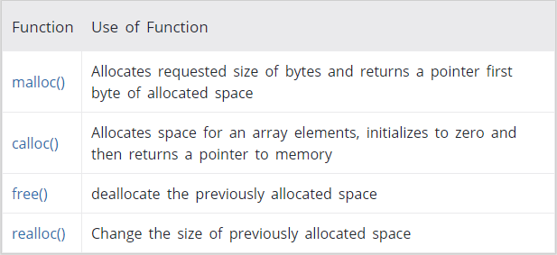

Slide 4
malloc()
The name malloc stands for "memory allocation".
The function malloc() reserves a block of memory of specified size and return a pointer of type void which can be casted into pointer of any form.
Syntax of malloc()
ptr = (cast-type*) malloc(byte-size)
Here, ptr is pointer of cast-type. The malloc() function returns a pointer to an area of memory with size of byte size. If the space is insufficient, allocation fails and returns NULL pointer.
ptr = (int*) malloc(100 * sizeof(int));
This statement will allocate either 200 according to size of int 2 bytes and the pointer points to the address of first byte of memory.

Slide 5
calloc()
The name calloc stands for "contiguous allocation".
The only difference between malloc() and calloc() is that, malloc() allocates single block of memory whereas calloc() allocates multiple blocks of memory each of same size and sets all bytes to zero.
Syntax of calloc()
ptr = (cast-type*)calloc(n, element-size);
This statement will allocate contiguous space in memory for an array of n elements. For example:
ptr = (float*) calloc(25, sizeof(float));
This statement allocates contiguous space in memory for an array of 25 elements each of size of float, i.e, 4 bytes.

Slide 6
Difference between malloc and calloc
 | Calloc | Malloc
Function | allocates a region of memory large enough to hold "n elements" of "size" bytes each. Also initializes contents of memory to zeroes. | allocates "size" bytes of memory.
Number of arguments | 2 | 1
Syntax | void *calloc (number_of_blocks, size_of_each_block_in_bytes); | void *malloc (size_in_bytes);
Contents of allocated memory | The allocated region is initialized to zero. | The contents of allocated memory are not changed. i.e., the memory contains unpredictable or garbage values. This presents a risk.
Return value | void pointer (void *). If the allocation succeeds, a pointer to the block of memory is returned. If the allocation of memory fails, a NULL pointer is returned. | void pointer (void *). If the allocation succeeds, a pointer to the block of memory is returned. If the allocation of memory fails, a NULL pointer is returned.

Slide 7
free()
Dynamically allocated memory created with either calloc() or malloc() doesn't get freed on its own. You must explicitly use free() to release the space.
syntax of free()
free(ptr);
This statement frees the space allocated in the memory pointed by ptr.

Slide 8
realloc()
If the previously allocated memory is insufficient or more than required, you can change the previously allocated memory size using realloc().
Syntax of realloc()
  ptr = realloc(ptr, newsize);
  Here, ptr is reallocated with size of newsize.

Slide 9
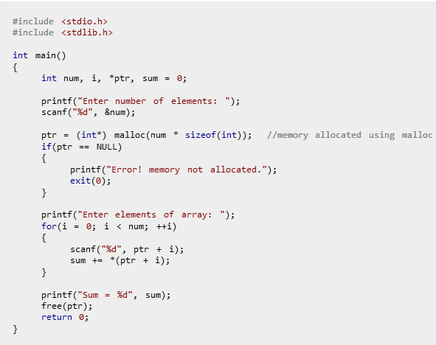
Example #1: Using C malloc() and free()
Write a C program to find sum of n elements entered by user. To perform this program, allocate memory dynamically using malloc() function.

Slide 10
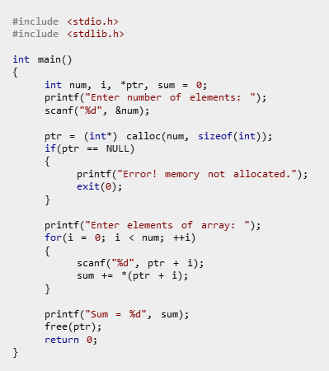
Example #2: Using C calloc() and free()
Write a C program to find sum of n elements entered by user. To perform this program, allocate memory dynamically using calloc() function.

Slide 11
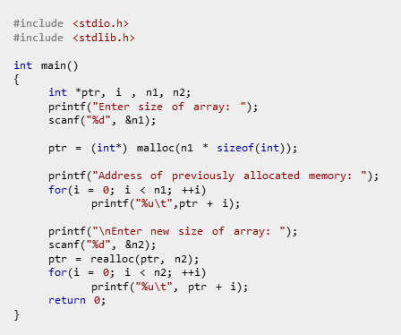
Example #3: Using realloc()

Slide 12
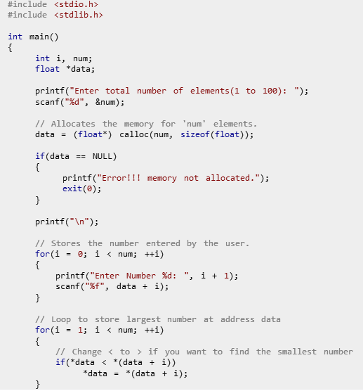
Example #4: Find Largest Element Using Dynamic Memory Allocation - calloc()

Slide 13

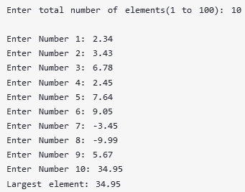
Example #4: Find Largest Element Using Dynamic Memory Allocation - calloc()
Output:

Slide 14
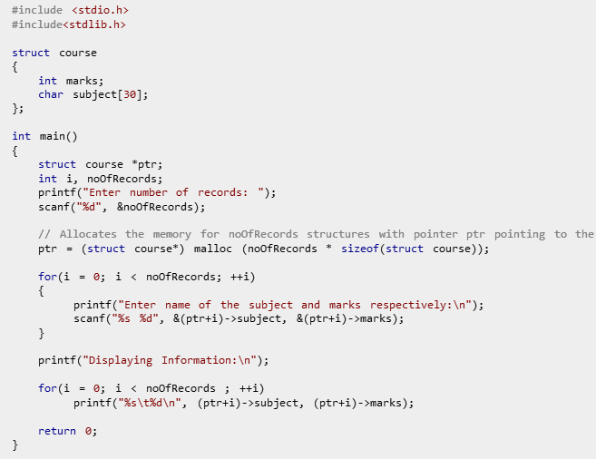
Example #4: Demonstrate the Dynamic Memory Allocation for Structure
Enter number of records: 2
Enter name of the subject and marks respectively: Programming 22
Enter name of the subject and marks respectively: Structure 33
Displaying Information:
Programming 22
Structure 33
Output

Slide 15
Design Linked List node
malloc returns a void pointer (void *), which indicates that it is a pointer to a region of unknown data type. The lack of a specific pointer type returned from malloc is type-unsafe behavior : malloc allocates based on byte count but not on type.
Example:
struct link
{
int info;
struct link *next;
};
struct link *start=NULL;
start = (struct link *) malloc ( sizeof (struct link) );
info next
120
*

Slide 16
Command Line Argument in C
Command line argument is a parameter supplied to the program when it is invoked. Command line argument is an important concept in C programming. It is mostly used when you need to control your program from outside. Command line arguments are passed to the main() method.
Syntax:
int main(int argc, char *argv[])
Here argc counts the number of arguments on the command line and
argv[ ] is a pointer array which holds pointers of type char which points to the arguments passed to the program.

Slide 17
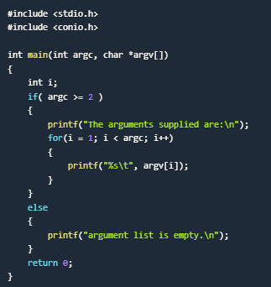
Example #5: Command Line Argument in C
Remember that argv[0] holds the name of the program and argv[1] points to the first command line argument and argv[n] gives the last argument. If no argument is supplied, argc will be 1.

Slide 18
Nested structure
We can define structure within the structure also. It requires less code than previous way. But it can't be used in many structures. We can access the member of nested structure by Outer_Structure.Nested_Structure.member as given below:
Accessing Nested Structure
struct Employee
{
int id;
char name[20];
struct Date
{
int dd;
int mm;
int yyyy;
}doj;
}emp1;
emp1.doj.dd
emp1.doj.mm
emp1.doj.yyyy

